Slide 1

(Academic Year:2022-23)
Project Review 1
on
Project Title : Designing a software toolset for storing geospatial data in Decentralized storage system.
by
Group Id : BI06 Group Member :
Om Gosavi
Ritu Mahajan
Nikita Rathod
Shreyash Sharma
Guide name: Prof. Prashant M.

Slide 2

Outline
Problem statement
Introduction
Literature Survey/Related work
Motivation, objectives, and scope of the project
Resource requirement
System overview- Proposed system, Architecture and initial phase of design (DFD) and expected outcomes
References

Slide 3
Problem statement
Designing a software toolset for storing geospatial data in Decentralized storage system.

Slide 4
Introduction
In today’s world data is been produced in huge quantity. So, we need to store the data in efficient and secure manner, this is possible by using some of the new technologies like, Blockchain, IPFS. Also, due to centralised storage system, sometimes data becomes inaccessible if there is load in any server. So, we need to make it decentralized which will make data available, even if few servers go down. Decentralization can be held on many platforms, but we are going to use IPFS for decentralization, storage of data & Blockchain for the secured transaction of the data.

Slide 5
Literature Survey/Related work
Year and Title | Algorithm | Result | Limitations /Drawbacks
(August 2022) Design and Evaluation of IPFS: A Storage Layer for the Decentralized Web | 1. SHA-256 (Open External Link) - For Input. 2. Base58 (Open External Link) - For Output. | 1. Content Based Addressing. 2. All files having unique hash. 3. Security Built-in. 4. Deduplication 5. Chunk size 256kb. 6. Versioning. | 1. Node containing the particular copy can go offline. 2. No copy will be remaining for requester. 3. Consumes lot of bandwidth. 4. Storing data on IPFS is expensive.
(April 2022) Towards Blockchain-Based Secure Storage and Trusted Data Sharing Scheme for IoT Environment | 1. Comparison of Ethereum, Hyperledger, Bitcoin. 2. Smart Contract 3. IPFS Smart Contract | 1. Data encryption and permission based access 2. Smart contracts perform search process with predefined logic. 3. storage nodes can only see a subset of the cipher-texts and have no access to any file metadata. | 1. Access Control Scheme. 2. Off-Chain Database Storage and IOT Integration.

Slide 6
Literature Survey/Related work
Year and Title | Algorithm | Result | Limitations /Drawbacks
(January 2022) Blockchain based hierarchical semi-decentralized approach using IPFS for secure and efficient data sharing | 1. IPFS 2.SHA256. 3.semi-decentralized system 4.Hyperledger | 1.Avoid single point of failure 2.Security achieved by Auditable Property of Blockchain which prevents collision attacks and achieve authentication. 3..distribution key is no longer reliant on the centre authority to prevent an attack on it | 1. calculation overhead of decryption on the user side 2. every system should installed with IPFS 3. Storing data on IPFS is expensive.
(April 2022) PeerMon: A Peer-to-Peer Network Monitoring System | PeerMon smarterSSH autoMPIgen dynamic DNS binding system | 1.peer-to-peer resource monitoring system for Unix local area network systems 2.Implement tools use PeerMon data to pick nodes for job or process placement in a LAN | Because of artificial workloads on some nodes to ensure more variation in resource usage across nodes.

Slide 7
Motivation, objectives, and scope of the project
This project deals with Decentralization of data by designing a storage system which will solve problems like bandwidth throughput , availability of data , Security etc.
The objective of the project is to Design a decentralized storage system in which all the transactions of data will be stored in blockchain which will include use of cryptography in it.
Centralized systems dominate the market but as data is increasing most companies are moving towards decentralized systems as it’s not efficient to manage data using traditional technologies.

Slide 8
Resource requirement
IPFS Network.
Ganache.
Public Servers.
NodeJS
Solidity.

Slide 9
System overview- Proposed system, Architecture and initial phase of design (DFD) and expected outcomes
Client | Guardian Server | Nodes
Upload and Download Web portal. Encryption , Decryption | Generating keys Verify connections Meta Data collection, analysis Blockchain transactions Security and Health | Routing Data storage File System Sending Reports

Slide 10
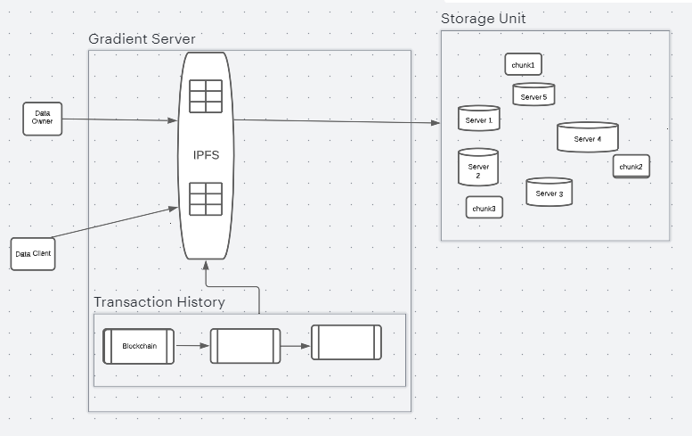
Architecture

Slide 11
References
Dennis Trautwein, Aravindh Raman, Gareth Tyson, Ignacio Castro, Will Scott, Moritz Schubotz, Bela Gipp, and Yiannis Psaras. 2022. Design and Evaluation of IPFS: A Storage Layer for the Decentralized Web. In ACM SIGCOMM 2022 Conference (SIGCOMM ’22), August 22–26, 2022, Amsterdam, Netherlands. ACM, New York, NY, USA, 14 pages. https://doi.org/10.1145/ 3544216.3544232
Design and Evaluation of IPFS: A Storage Layer for the Decentralized Web
Z. Ullah, B. Raza, H. Shah, S. Khan and A. Waheed, "Towards Blockchain-BasedSecureStorage and Trusted Data Sharing Scheme for IoT Environment," in IEEE Access, vol. 10, pp.36978-36994, 2022, doi: 10.1109/ACCESS.2022.3164081.
Athanere, Smita, and Ramesh Thakur. "Blockchain based hierarchical semi-decentralized approach using IPFS for secure and efficient data sharing." Journal of King Saud University-Computer and Information Sciences 34.4 (2022): 1523-1534.:Blockchain based hierarchical semi-decentralized approach using IPFS for secure and efficient data sharing
Alizadeh, K. Andersson and O. Schelén, "Efficient Decentralized Data Storage BasedonPublic Blockchain and IPFS," 2020 IEEE Asia-Pacific Conference on Computer ScienceandData Engineering (CSDE), 2020, pp. 1-8, doi: 10.1109/CSDE50874.2020.9411599.

